Slide 1

Samsung Innovation Campus
Artificial Intelligence Course
Notes:
Note:

Slide 2
Chapter 5.
Machine Learning - Part I
AI Course
Notes:
Note:

Slide 3
Samsung Internal Use Only
Update History
Version | Update Details
v1.0 | 1st draft completed
v1.01 | ‘Guide for Instructors’ page inserted ‘Enabling People’ logo replaced
v1.02 | Front and Cover page layout updated ‘Coding Exercise’ replaced ‘Coding Practice’ ‘Quiz.’ replaced ‘Coding Problem’
V1.03 | Samsung, SIC logo updated
V1.04 | Chapter info. updated
Notes:
Note:

Slide 4
Course Description (1/2)
Duration: 54 Hours.
Purpose:
Introduction to machine learning concepts and related Python libraries.
Introduction to supervised and unsupervised learning.
Introduction to clustering, regression, classification and natural language processing.
Target Audience:
This course is required to build solid basis on machine learning and AI.
This course is a prerequisite for deep learning.
Prerequisite:
A student taking this course should be familiar with NumPy and Pandas libraries.
A student taking this course should be knowledgeable about statistics and some linear algebra.
Notes:
Note:

Slide 5
Course Description (2/2)
Objectives:
Preprocess data in a way that is most suitable to the given machine learning algorithm.
Create new features to suit the needs of the machine learning algorithms.
Select and apply the most suitable machine learning algorithm for the given problem.
Carry out hyperparameter tuning.
Design, maintain and optimize machine learning workflow.
AI modeling with structured and unstructured data.
Notes:
Note:

Slide 6
Chapter 5.
Machine Learning - Part I
UNIT 2.
Unsupervised Learning
Notes:
Note:

Slide 7
Unit 2.
Unsupervised Learning
What this unit is about:
You will learn about the unsupervised machine learning.
You will learn about various clustering algorithms.
You will learn how to do matrix decompositions.
You will learn about the principal components and their applications.
Expected outcome:
Ability to utilize the Scikit-Learn library for predictive analysis with clustering.
Ability to calculate principal components and coordinate transformations.
Ability to utilize principal components for visualization and feature engineering purposes.
How to check your progress:
Coding Exercises.
Quiz.
Notes:
Note:

Slide 8
Chapter 5.
Machine Learning - Part I
UNIT 1. Data Preprocessing
UNIT 3. Regression
1.1. Machine learning with Scikit-Learn
1.2. Data Preprocessing
1.3. Feature Engineering
3.1. Training and Testing in Machine Learning
3.2. Linear Regression Basics
3.3. Linear Regression Diagnostics
3.4. Other Regression Types
UNIT 2. Unsupervised Learning
2.1. Clustering Analysis
2.2. Principal Component Analysis (PCA)
2.3. Applications of Principal Components
Notes:
Note:

Slide 9
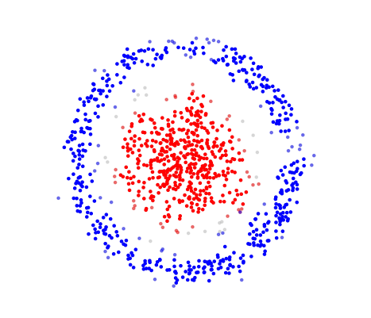
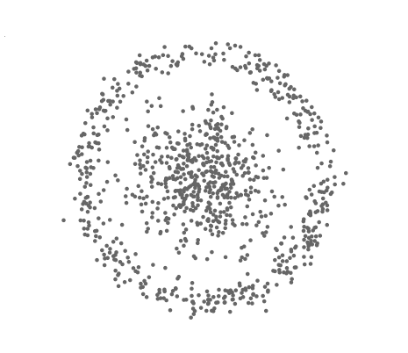
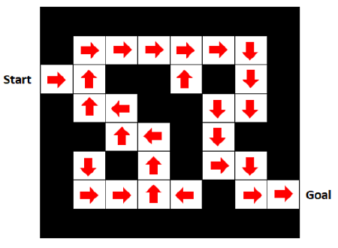
UNIT 2. 2.1. Clustering Analysis
Machine Learning Types
Machine Learning
Supervised
Unsupervised
Reinforcement
Target pattern is given.
Target pattern must be found out.
Policy optimization.
Notes:
Note:
It was mentioned that there are three main types of machine learning.
In this unit, we will see some concrete examples of the unsupervised learning.
This is the case where the response variable $Y$ does not exist and we should find out the hidden pattern.

Slide 10
UNIT 2. 2.1. Clustering Analysis
K-Means Clustering (1/8)
About the k-means clustering:
There is one ore more explanatory variables 𝑋₁ , 𝑋₂ , …, 𝑋_{𝑑}
There is no response variable. Hence, this is a unsupervised learning algorithm.
Purpose of the k-means clustering:
Cluster the observations in 𝑘 clusters.
Find the centroids (cluster means) that characterize the clusters.
Notes:
Note:
K-means clustering is a unsupervised learning algorithm.
There are only explanatory variables.

Slide 11
UNIT 2. 2.1. Clustering Analysis
K-Means Clustering (2/8)
Pros:
Intuitive interpretation of the results.
Quick and easy
Cons:
Sensitive to the noise and outliers.
Cluster boundaries can only be linear.
Notes:
Note:
K-means is a quick and easy-to-understand algorithm.
The internal mechanism is straightforward.
However, it has clear limitations as outlined here.

Slide 12
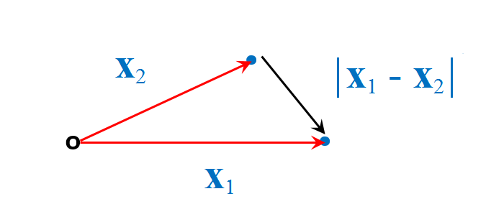
UNIT 2. 2.1. Clustering Analysis
K-Means Clustering (3/8)
Distance metric:
Euclidean distance: it is the modulus of the difference between two position vectors.
$$\left|X_{1}−X_{2}\right|=\sqrt{{\left(x_{11}−x_{21}\right)}^{2}+{\left(x_{12}−x_{22}\right)}^{2}+…+{\left(x_{1d}−x_{2d}\right)}^{2}}$$
Notes:
Note:
First of all, we should define the distance metric.
The physical distance metric we are all familiar with has a name: “Euclidean distance”.
Here, we give it a formal definition.

Slide 13
UNIT 2. 2.1. Clustering Analysis
K-Means Clustering (4/8)
Distance metric:
For numeric variables:
Euclidean, Standardized, Mahalanobis, Chebyshev, Canberra, Manhattan, Minkowski, etc.
For categorical variables:
Jackard, etc.
Black: Euclidean / Colored: Manhattan.
Notes:
Note:
There are a bunch of other distance metrics.
Strictly speaking they are not “distance” in the physics sense.
They should be understood as measures of “closeness”.

Slide 14
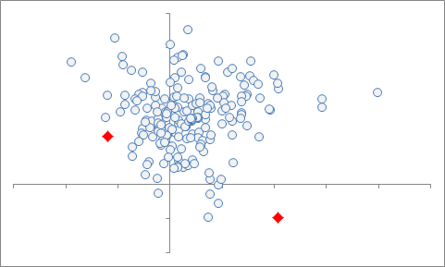
UNIT 2. 2.1. Clustering Analysis
K-Means Clustering (5/8)
Standard algorithm:
1) Let’s suppose a dataset composed of 𝑛 observations:
𝒙₁, 𝒙₂, ⋯, 𝒙_{𝑛}
Each observation 𝒙𝑖 is a vector of 𝑑 components (𝑑 = number of variables) .
2) Suppose that we target two (𝑘=2) clusters, denoted as 𝐶₁ and 𝐶₂.
3) Two centroid positions are randomly initialized: 𝜇₁ and 𝜇₂.
Notes:
Note:
Here, the so-called standard algorithm of k-means clustering is explained step by step.
We assume an example where we would like to find two clusters.

Slide 15
UNIT 2. 2.1. Clustering Analysis
K-Means Clustering (6/8)
Standard algorithm:
4) Assign the observations to the nearest centroids.
5) Update the centroid positions such that the sum of square distances between the observations and the nearest centroids gets smaller.
$$minimize \sum_{i=1}^{k}{\sum_{x∈C_{i}}{{\left|x−μ_{i}\right|}^{2}}}$$
6) Repeat from the step 4) until the centroids converge to their final positions.
Notes:
Note:
Here, the step by step explanation of the standard algorithm continues.
It is important to notice that this algorithm is “iterative”: we converge to the solution in several small steps.

Slide 16
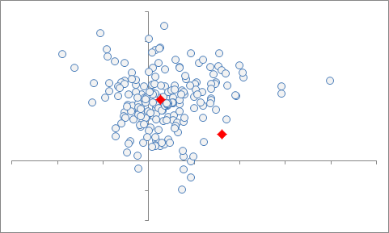
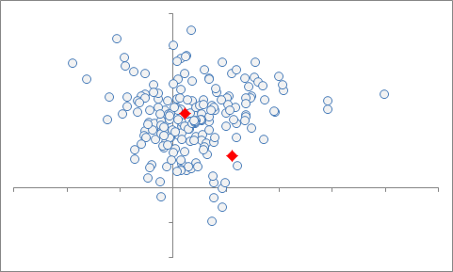
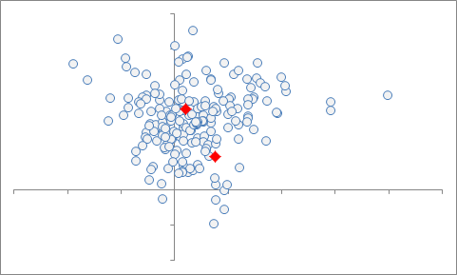
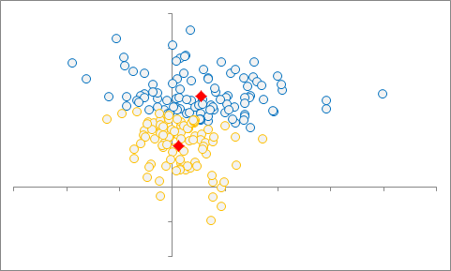
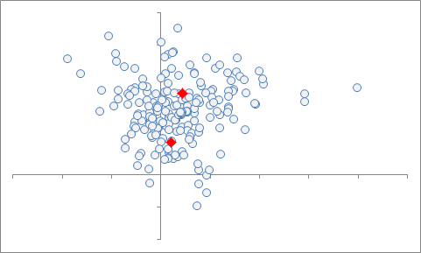

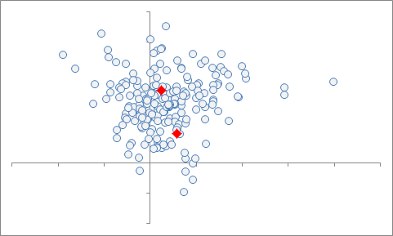
UNIT 2. 2.1. Clustering Analysis
K-Means Clustering (7/8)
Standard algorithm:
Start
Finish
Notes:
Note:
The standard algorithm is illustrated with an example where two clusters are sought.
We can easily generalize this to an arbitrary number of clusters.

Slide 17
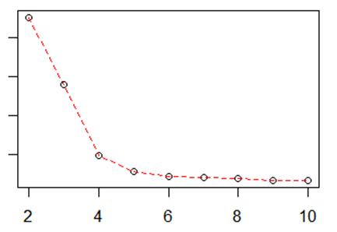
UNIT 2. 2.1. Clustering Analysis
K-Means Clustering (8/8)
Standard algorithm:
A question: how do we find the optimal number of clusters?
Let’s define the sum of square distances between the observations and the nearest centroids as:
$$Total internal sum of squares= \sum_{i=1}^{k}{\sum_{x∈C_{i}}{{\left|x−μ_{i}\right|}^{2}}}$$
Plot the “Total internal sum of squares” vs “N# of clusters” and find the inflexion point ← “Elbow”.
Total internal SS
N# of Clusters
Notes:
Note:
Here, the so-called “Elbow” method is explained.
Using this method, we can find the optimal number of clusters.
There is another method based on the “silhouette scores” to optimize the number of clusters.

Slide 18

UNIT 2. 2.1. Clustering Analysis
Coding Exercise #0401
Follow practice steps on 'ex_0401.ipynb’ file.
Notes:
Note:
WHAT THIS PRACTICE ABOUT
In this practice, we apply k-means clustering to a simulated dataset.
PRACTICE INSTRUCTION
Click Window button.
Search the “anaconda prompt” and Run.
Type the command "jupyter notebook" and press Enter.
In Jupyter Notebook, go to the folder containing the practice files. (If you don’t have practice files yet, ask your instructor)
Click Coding Exercise folder.
Click the ex_0401.ipynb file.
Review the examples on the topics below: A. K-Means clustering with simulated data. i. Generate simulated data and visualize. ii. Apply k-means clustering and visualize.
(Optional) Use the blank cell at the bottom to practice your own personal needs.

Slide 19
UNIT 2. 2.1. Clustering Analysis
Coding Exercise #0402
Follow practice steps on 'ex_0402.ipynb’ file.
Notes:
Note: WHAT THIS PRACTICE ABOUT
In this practice, we apply k-means clustering to a real dataset.
PRACTICE INSTRUCTION
Start Jupyter Notebook. (Refer to steps 1-3 of Coding Exercise # 0401.)
In Jupyter Notebook, click the ex_0402.ipynb files in the Coding Exercise folder.
Review the examples on the topics below: A. K-Means clustering with real data i. Load the 'Iris' dataset from Seaborn ii. Apply k-means iii. Visualize iv. Prediction based on what we have learned
(Optional) Use the blank cell at the bottom to practice your own personal needs.

Slide 20
UNIT 2. 2.1. Clustering Analysis
Hierarchical Clustering (1/4)
About the hierarchical clustering:
This is a unsupervised learning algorithm: there are only 𝑋 variables.
Also called “agglomerative clustering”.
Nearest items are gathered to form ever growing clusters.
Can be visualized resembling an inverted tree-like structure called “dendrogram”.
Purpose of the hierarchical clustering:
Cluster the observations into a given number of clusters.
Notes:
Note:
A different clustering algorithm is introduced.
This time around, it is the “hierarchical clustering”.

Slide 21
UNIT 2. 2.1. Clustering Analysis
Hierarchical Clustering (2/4)
Pros:
Intuitive interpretation of the results.
Dendrogram that can be further processed to produce a desired number of clusters.
Cons:
A bit more time consuming than k-means.
Notes:
Note:
The pros and cons of the hierarchical clustering are listed.

Slide 22
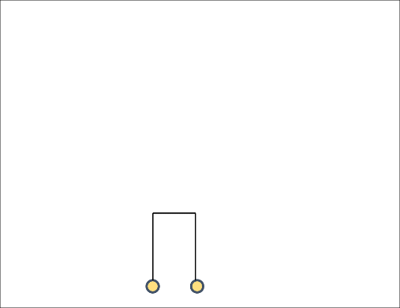
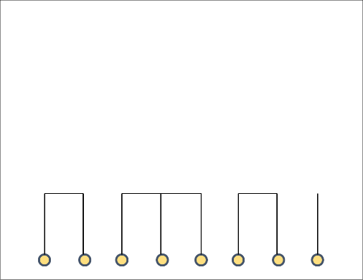
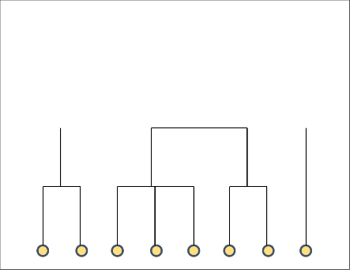
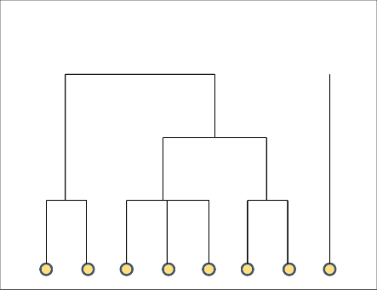
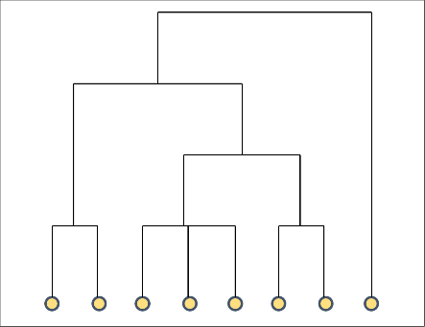
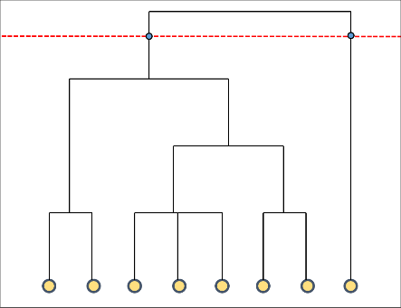
UNIT 2. 2.1. Clustering Analysis
Hierarchical Clustering (3/4)
Hierarchical clustering algorithm:
(a)
(b)
(c)
(d)
(e)
(f)
1) First, group together the nearest observations and get small clusters: (a) ~ (b).
2) Group the nearest clusters together to forma larger clusters: (c).
3) Repeat from the step 2) until all the observations are grouped together into a single cluster: (d) ~ (e).
4) Cut the dendrogram at an appropriate height such that we get the desired number of clusters: (f).
Notes:
Note:
Here, the hierarchical clustering algorithm is illustrated.

Slide 23
UNIT 2. 2.1. Clustering Analysis
Hierarchical Clustering (4/4)
Hierarchical clustering algorithm:
How do we measure the inter-cluster distances?
Single linkage
Complete linkage
Average linkage
Notes:
Note:
When we merge small clusters into larger ones, we can apply different criteria to measure the inter-cluster distances.
+Single linkage: measures the distance between the closest points.
+Complete linkage: measures the distance between the most distant points.
+Average linkage: measures the distance between the centers.

Slide 24
UNIT 2. 2.1. Clustering Analysis
DBSCAN (1/2)
About the DBSCAN:
This is a unsupervised learning algorithm: there are only 𝑋 variables.
Developed in 1996.
Allows density based clustering.
Pros:
Can reveal structures that the k-means and hierarchical clustering cannot.
Cons:
Hyperparameters eps and minPts must be specified.
Hard to get stable clusters in case the dense regions overlap.
Notes:
Note:
DBSCAN clustering algorithm is introduced.
This is not distance based as k-means or hierarchical, but a density based algorithm.
There are two hyperparameters that should be tuned.
There are several pros and cons.

Slide 25
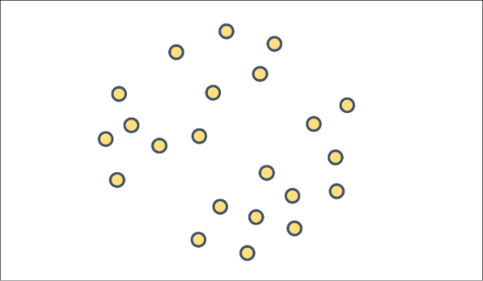
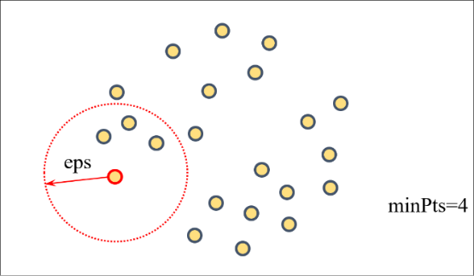
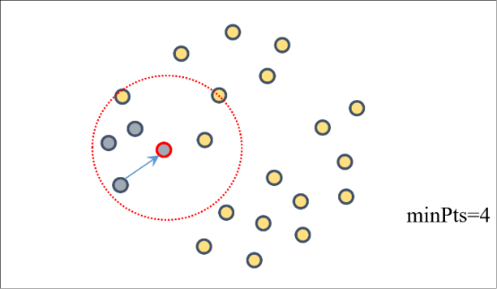
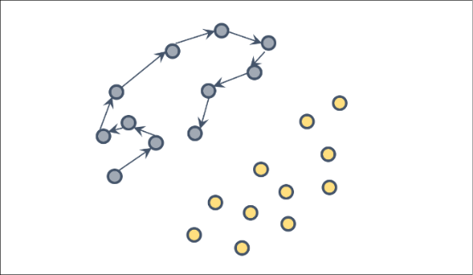
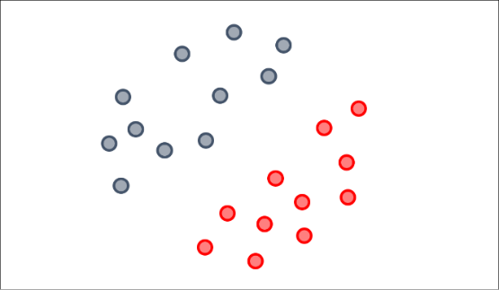
UNIT 2. 2.1. Clustering Analysis
DBSCAN (2/2)
DBSCAN algorithm:
(a)
(b)
(c)
(d)
(e)
1) Suppose that the observations are distributed as in (a).
2) From a point, count the points within a radius eps and look around: (b).
3) If there are more than minPts points within the circle, include them in the same cluster: (b).
4) Then move on to the next point and repeat from the step 2) until all the points are exhausted: (c)~(d).
5) Move on to another point that has not been clustered yet. Repeat from the step 2): (e).
Notes:
Note:
The DBSCAN algorithm is illustrated step by step with an example.

Slide 26
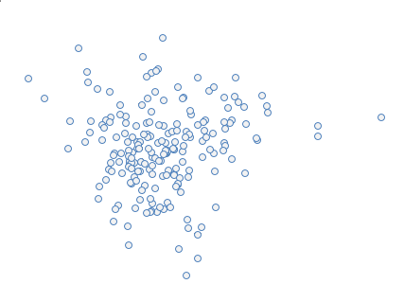
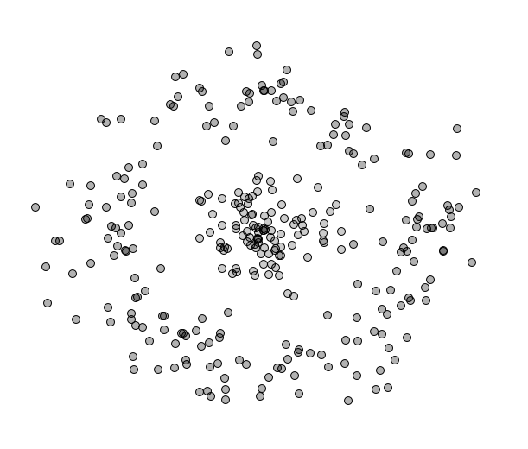
UNIT 2. 2.1. Clustering Analysis
Clustering
Question: which clustering algorithms are suitable for the following cases?
(a)
(b)
Notes:
Note:
Short answer below:
+In (a):
DBSCAN will create a big cluster around the middle leaving out the points in the periphery as unclustered outliers.
If we desire clusters of even size, we would rather go with k-means.
+In (b):
We can visually identify a dense region at the “core” and another dense region at the “shell”.
k-means will not be able to distinguish them as separate clusters.
DBSCAN, if well tuned, potentially would work.

Slide 27
UNIT 2. 2.1. Clustering Analysis
Coding Exercise #0403
Follow practice steps on 'ex_0403.ipynb’ file.
Notes:
Note: WHAT THIS PRACTICE ABOUT
In this practice, we compare different clustering algorithms and discuss pros and cons.
PRACTICE INSTRUCTION
Start Jupyter Notebook. (Refer to steps 1-3 of Coding Exercise # 0401.)
In Jupyter Notebook, click the ex_0403.ipynb files in the Coding Exercise folder.
Review the examples on the topics below: A. Compare clustering algorithms. i. Generate simulated data and visualize. ii. Apply k-means clustering and visualize. iii. Apply agglomerative clustering and visualize iv. Apply hierarchical clustering and visualize. v. Apply DBSCAN and visualize
(Optional) Use the blank cell at the bottom to practice your own personal needs.

Slide 28
Chapter 5.
Machine Learning - Part I
UNIT 1. Data Preprocessing
UNIT 3. Regression
1.1. Machine learning with Scikit-Learn
1.2. Data Preprocessing
1.3. Feature Engineering
3.1. Training and Testing in Machine Learning
3.2. Linear Regression Basics
3.3. Linear Regression Diagnostics
3.4. Other Regression Types
UNIT 2. Unsupervised Learning
2.1. Clustering Analysis
2.2. Principal Component Analysis (PCA)
2.3. Applications of Principal Components
Notes:
Note:

Slide 29
UNIT 2. 2.2. Principal Component Analysis (PCA)
Principal Component Analysis (1/9)
Purpose of the principal component analysis (PCA):
Transform a set of correlated variables into another set of uncorrelated variables.
Get a new set of orthogonal vectors (principal components or PCs).
Order the new variables from the largest to the smallest variance.
Pros:
Many data science applications: preprocessing, modeling, dimensional reduction, visualization, etc.
Cons:
Difficult to interpret as PCs are obtained by linear combinations of the original features.
Notes:
Note:
Here, the purpose and benefits of the PCA are outlined.
The main shortcoming of the principal components lies in the fact that they are hard to interpret intuitively.

Slide 30
UNIT 2. 2.2. Principal Component Analysis (PCA)
Principal Component Analysis (2/9)
Terminology:
a) Loading:
Normalized principal component (PC).
There are as many loading vectors as the number of variables.
b) Variance 𝜎^² (or standard deviation 𝜎):
The principal components have associated variances.
c) Transformed scores:
Raw scores (original observations) represented using the PCs as new coordinate axes.
Notes:
Note:
The related terminology is explained.

Slide 31
UNIT 2. 2.2. Principal Component Analysis (PCA)
Principal Component Analysis (3/9)
Principal components:
Let’s suppose that there are 𝑘 variables or features 𝑋₁ , 𝑋₂ , …, 𝑋_{𝑘}.
Then, the 𝑃𝐶₁ , 𝑃𝐶₂ , …, 𝑃𝐶_{𝑘} are linear combinations of the original features.
𝑃𝐶_{𝑖}=𝛼_{1, 𝑖}𝑋₁+𝛼_{2, 𝑖}𝑋₂+…+𝛼_{𝑘, 𝑖}𝑋_{𝑘}
Conversely, the original features can be expressed in terms of the PCs:
𝑋_{𝑖} = 𝛽_{1, 𝑖}𝑃𝐶₁ + 𝛽_{2, 𝑖}𝑃𝐶₂+…+𝛽_{𝑘, 𝑖}𝑃𝐶_{𝑘}
Notes:
Note:
In the essence, a principal component (PC) is a linear combination of the original features or variables.
Conversely, the original features can be expressed as linear combinations of the PCs.

Slide 32
UNIT 2. 2.2. Principal Component Analysis (PCA)
Principal Component Analysis (4/9)
Principal component and variance:
Suppose a dataset with two variables that can be conveniently visualized on a plane:
$$X_{2}$$
$$X_{1}$$
Notes:
Note:
This is an example with two variables: $X_{1}$ and $X_{2}$.

Slide 33
UNIT 2. 2.2. Principal Component Analysis (PCA)
Principal Component Analysis (5/9)
Principal component and variance:
We can find the 𝑃𝐶₁ and 𝑃𝐶₂ that are orthogonal to each other.
$$X_{2}$$
$$X_{1}$$
Notes:
Note:
We can find the ${PC}_{1}$ and ${PC}_{2}$ that are orthogonal to each other.

Slide 34
UNIT 2. 2.2. Principal Component Analysis (PCA)
Principal Component Analysis (6/9)
Principal component and variance:
𝑃𝐶₁ is the direction of largest variance, while 𝑃𝐶₂ is the direction of the next largest variance.
$$X_{2}$$
$$X_{2}$$
$$X_{1}$$
$$σ_{2}$$
$$X_{1}$$
$$σ_{1}$$
So, we have 𝜎₁ > 𝜎₂.
Notes:
Note:
Here, we interpret what the ${PC}_{1}$ and ${PC}_{2}$ represent.

Slide 35
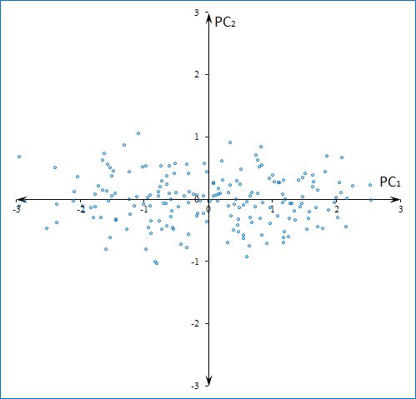
UNIT 2. 2.2. Principal Component Analysis (PCA)
Principal Component Analysis (7/9)
Transformed scores:
The observations can be represented using the 𝑃𝐶₁ and 𝑃𝐶₂ as new coordinate axes.
$${PC}_{2}$$
$${PC}_{1}$$
Notes:
Note:
Here, we made a rotation (transformation) so that the coordinate axes are now ${PC}_{1}$ and ${PC}_{2}$.

Slide 36
UNIT 2. 2.2. Principal Component Analysis (PCA)
Principal Component Analysis (8/9)
Cumulative variance:
As the principal components can be regarded as independent variables, the total variance is:
$$σ_{total}^{2}=σ_{1}^{2}+σ_{2}^{2}+σ_{3}^{2}+…$$
So, we can calculate the cumulative variance ratios (CVRs):
$${CVR}_{1}=\frac{σ_{1}^{2}}{σ_{total}^{2}}$$
CVR
1
$${CVR}_{2}=\frac{σ_{1}^{2}+σ_{2}^{2}}{σ_{total}^{2}}$$
$${CVR}_{3}=\frac{σ_{1}^{2}+σ_{2}^{2}+σ_{3}^{2}}{σ_{total}^{2}}$$
$$⋮$$
0
Number of PCs
Notes:
Note:
We can gather the variances along the principal components and analyze.
As we accumulate the variances, the cumulative variance ratio approaches one.

Slide 37
UNIT 2. 2.2. Principal Component Analysis (PCA)
Principal Component Analysis (9/9)
Calculating the principal components:
The PCs can also be obtained by eigenvalue decomposition (ED) of the covariance matrix.
The PCs can be calculated by singular value decomposition (SVD) of the data matrix.
If we standardize the variables, then instead of the covariance we would have the correlation.
Ex) A covariance matrix and a correlation matrix.
$\left[\begin{matrix}\begin{matrix}σ_{1}^{2} & σ_{12} \\ σ_{21} & σ_{2}^{2}\end{matrix} & \begin{matrix}σ_{13} & σ_{14} \\ σ_{23} & σ_{24}\end{matrix} \\ \begin{matrix}σ_{31} & σ_{32} \\ σ_{41} & σ_{42}\end{matrix} & \begin{matrix}σ_{3}^{2} & σ_{34} \\ σ_{43} & σ_{4}^{2}\end{matrix}\end{matrix}\right]$ $\left[\begin{matrix}\begin{matrix}1 & ρ_{12} \\ ρ_{21} & 1\end{matrix} & \begin{matrix}ρ_{13} & ρ_{14} \\ ρ_{23} & ρ_{24}\end{matrix} \\ \begin{matrix}ρ_{31} & ρ_{32} \\ ρ_{41} & ρ_{42}\end{matrix} & \begin{matrix}1 & ρ_{34} \\ ρ_{43} & 1\end{matrix}\end{matrix}\right]$
“
”
In the next few slides, let’s make a detour and review the ED and SVD in detail
Notes:
Note:
The PCs can be calculated either by eigenvalue decomposition (ED) or by singular value decomposition (SVD).
By “data matrix”, we are talking about a matrix where each row is an observation and each column is a variable.

Slide 38
UNIT 2. 2.2. Principal Component Analysis (PCA)
Matrix Decompositions (1/8)
Eigenvalue decomposition (ED):
A square matrix 𝑴 is decomposed as 𝑴=𝑸 𝜦 𝑸^{𝒕}.
All the matrices have the same size: 𝑆𝑖𝑧𝑒(𝑴)=𝑆𝑖𝑧𝑒(𝑸)=𝑆𝑖𝑧𝑒(𝜦)=𝑚×𝑚.
m
$$M$$
=
$$Q$$
⋅
$$Λ$$
⋅
$$Q^{t}$$
m
m
m
m
m
m
m
Notes:
Note:
Here, the ED is explained.

Slide 39
UNIT 2. 2.2. Principal Component Analysis (PCA)
Matrix Decompositions (2/8)
Eigenvalue decomposition (ED):
A square matrix 𝑴 is decomposed as 𝑴=𝑸 𝜦 𝑸^{𝒕}.
Here, 𝜦 is a diagonal matrix that contains the “eigenvalues”.
$$Λ=\left[\begin{matrix}\begin{matrix}λ_{1} & 0 \\ 0 & λ_{2}\end{matrix} & ⋯ & \begin{matrix}0 \\ 0\end{matrix} \\ ⋮ & ⋱ & ⋮ \\ \begin{matrix}0 & 0\end{matrix} & ⋯ & λ_{m}\end{matrix}\right]$$
Notes:
Note:
$Λ$ is a diagonal matrix that contains the “eigenvalues”.
In the context of the PCA, we can identify these eigenvalues as variances.

Slide 40
UNIT 2. 2.2. Principal Component Analysis (PCA)
Matrix Decompositions (3/8)
Eigenvalue decomposition (ED):
A square matrix 𝑴 is decomposed as 𝑴=𝑸 𝜦 𝑸^{𝒕}.
The columns of 𝑸 are the so-called “eigenvectors”.
$$Q=\left[\begin{matrix}↑ & ⋯ & ↑ \\ q_{1} & ⋯ & q_{m} \\ ↓ & ⋯ & ↓\end{matrix}\right]$$
Between an eigenvector and its eigenvalue we have the following relation:
$${Mq}_{i}=λ_{i} q_{i}$$
Between any two eigenvectors, we have the following orthogonality condition:
$q_{i} ∙q_{j}=δ_{ij}$ ⇔ ${QQ}^{t}=Q^{t}Q=I$
Notes:
Note:
The columns of $Q$ are the so-called “eigenvectors”.
In the context of the PCA, we can identify these eigenvectors as principal components.

Slide 41
UNIT 2. 2.2. Principal Component Analysis (PCA)
Matrix Decompositions (4/8)
Singular value decomposition (SVD):
A matrix 𝑴 is decomposed as 𝑴=𝑼𝜮𝑽^{𝒕}.
m
$$M$$
=
$$U$$
⋅
$$Σ$$
⋅
m
m
n
$$V^{t}$$
n
n
m
n
Notes:
Note:
Here, the SVD is explained.

Slide 42
UNIT 2. 2.2. Principal Component Analysis (PCA)
Matrix Decompositions (5/8)
Singular value decomposition (SVD):
A matrix 𝑴 is decomposed as 𝑴=𝑼𝜮𝑽^{𝒕}.
Here, 𝜮 contains the singular values as diagonal elements.
These singular values are ordered from the largest to the smallest: 𝜎₁>𝜎₂>…>𝜎_{𝑚}
$$Σ=\left[\begin{matrix}\begin{matrix}σ_{1} & 0 \\ 0 & σ_{2}\end{matrix} & ⋯ & \begin{matrix}0 & 0 \\ 0 & 0\end{matrix} \\ ⋮ & ⋱ & ⋮ \\ \begin{matrix}0 & 0\end{matrix} & ⋯ & \begin{matrix}σ_{m} & 0\end{matrix}\end{matrix}\right]$$
Notes:
Note:
$Σ$ contains the “singular values” as diagonal elements.
In the context of the PCA, we can identify these singular values as square roots of the variances (standard deviations).

Slide 43
UNIT 2. 2.2. Principal Component Analysis (PCA)
Matrix Decompositions (6/8)
Singular value decomposition (SVD):
A matrix 𝑴 is decomposed as 𝑴=𝑼𝜮𝑽^{𝒕}.
The columns of 𝑼 are the “left singular vectors”.
The columns of 𝑽 are the “right singular vectors”.
$=\left[\begin{matrix}↑ & ⋯ & ↑ \\ u_{1} & ⋯ & u_{m} \\ ↓ & ⋯ & ↓\end{matrix}\right]$ $V=\left[\begin{matrix}↑ & ⋯ & ↑ \\ v_{1} & ⋯ & v_{n} \\ ↓ & ⋯ & ↓\end{matrix}\right]$
Between a set of the left and right singular vectors and their singular value we have:
$$={M v}_{i}=σ_{i} u_{i}$$
Between any two singular vectors, we have the following orthogonality condition:
$v_{i} ∙v_{j}=δ_{ij}$ ⇔ $VV^{t}=V^{t}V=I$
$u_{i} ∙u_{j}=δ_{ij}$ ⇔ ${UU}^{t}=U^{t}U=I$
Notes:
Note:
For SVD, there are left singular vectors and right singular vectors.
Singular vectors and singular values are all related.
The left singular vectors are orthogonal among them. This can be compactly expressed as ${UU}^{t}=U^{t}U=I$.
The right singular vectors are orthogonal among them. This can be compactly expressed as $VV^{t}=V^{t}V=I$.

Slide 44
UNIT 2. 2.2. Principal Component Analysis (PCA)
Matrix Decompositions (7/8)
Relation between ED and SVD:
1) If 𝑿 is a matrix composed of standardized scores, then we can apply SVD: 𝑿=𝑼𝜮𝑽^{𝒕}.
2) Using the decomposed form, we can express the covariance matrix as following:
$$M=X X^{t}=U{ΣV}^{t}{\left(U{ΣV}^{t}\right)}^{t}$$
$$=U{ΣV}^{t} VΣ^{t}U^{t}$$
$$=U{ΣΣ}^{t}U^{t}$$
By orthogonality $V^{t}V=I$
We can see that 𝜮𝜮^{𝒕} is a diagonal matrix with elements equal to 𝜎𝑖².
Thus, 𝜮𝜮^{𝒕} is the same as the eigenvalue matrix 𝜦.
Also, we can see that the left singular matrix 𝑼 is the same as the eigenvector matrix 𝑸.
Notes:
Note:
Here, we “connect” the ED with the SVD.

Slide 45
UNIT 2. 2.2. Principal Component Analysis (PCA)
Matrix Decompositions (8/8)
Relation between ED and SVD:
Let’s summarize in the following table.
ED | SVD
$$X X^{t}=Q Λ Q^{t}$$ | $$X X^{t}=U{ΣΣ}^{t}U^{t}$$
$$Λ={ΣΣ}^{t}$$
$$Q=U$$
Notes:
Note:
Here, we summarize in a table the relation between ED and SVD.

Slide 46
UNIT 2. 2.2. Principal Component Analysis (PCA)
Principal Component Analysis
Calculating the principal components:
Finally, let us summarize the PCA in terms of the matrix decompositions.
 | ED | SVD
Decomposition Target | Covariance matrix $XX^{t}$. | Data matrix $X$.
$$PCs$$ | Columns of the $Q$ matrix. | Columns of the $U$ matrix.
$σ_{i}^{2}$ or $σ_{i}$ | Diagonal elements of the $Λ$ matrix are the $σ_{i}^{2}$. | Diagonal elements of the $Σ$ matrix are the $σ_{i}$.
Notes:
Note:
Ending our linear algebra detour, we come back to the PCA.
We summarize the matrix decompositions in the context of the PCA.

Slide 47
Chapter 5.
Machine Learning - Part I
UNIT 1. Data Preprocessing
1.1. Machine learning with Scikit-Learn
1.2. Data Preprocessing
1.3. Feature Engineering
UNIT 2. Unsupervised Learning
2.1. Clustering Analysis
2.2. Principal Component Analysis (PCA)
2.3. Applications of Principal Components
UNIT 3. Regression
3.1. Training and Testing in Machine Learning
3.2. Linear Regression Basics
3.3. Linear Regression Diagnostics
3.4. Other Regression Types
Notes:
Note:

Slide 48
UNIT 2. 2.3. Applications of Principal Components
Dimensional Reduction (1/9)
About the dimensional reduction:
The number of principal components (PCs) is equal to the number of variables, say 𝑘.
The original variables 𝑋_{𝑖} can be expressed in terms of the PCs:
$$X_{i}=β_{1,i}{PC}_{1}+β_{2,i}{PC}_{2}+…+β_{k,i}{PC}_{k}$$
$$σ_{1}^{2}>σ_{2}^{2}>σ_{3}^{2}>…>σ_{k}^{2}$$
The PCs are ordered by variance:
So we can reduce dimension starting from the last PC, (𝑞 < 𝑘):
$$X_{i}≈β_{1,i}{PC}_{1}+β_{2,i}{PC}_{2}+…+β_{q,i}{PC}_{q}$$
“Reduced dimension input”
Notes:
Note:
Here, the dimensional reduction using PCs is explained.
The “reduced dimensional inputs” are approximations of the raw scores using a reduced basis set.

Slide 49
UNIT 2. 2.3. Applications of Principal Components
Dimensional Reduction (2/9)
Pros:
We can simplify the data and reduce overfitting error.
We get only the most salient features.
Cons:
Loss of details.
Difficult to interpret intuitively.
Notes:
Note:
The advantages and shortcoming of the dimensional reduction are listed.

Slide 50
UNIT 2. 2.3. Applications of Principal Components
Dimensional Reduction (3/9)
Dimensional reduction:
Suppose a dataset with two variables that can be conveniently visualized on a plane:
$$X_{2}$$
$$X_{1}$$
Notes:
Note:
This is an example with two variables: $X_{1}$ and $X_{2}$.

Slide 51
UNIT 2. 2.3. Applications of Principal Components
Dimensional Reduction (4/9)
Dimensional reduction:
The observations can be represented using the 𝑃𝐶₁ and 𝑃𝐶₂ as new coordinate axes:
$${PC}_{2}$$
$${PC}_{1}$$
$$σ_{1}$$
Notes:
Note:
If we transform (rotate) such that the ${PC}_{1}$ and ${PC}_{2}$ are the new coordinate axes, we have the largest variance along the ${PC}_{1}$ direction.

Slide 52
UNIT 2. 2.3. Applications of Principal Components
Dimensional Reduction (5/9)
Dimensional reduction:
The observations can be represented using the 𝑃𝐶₁ and 𝑃𝐶₂ as new coordinate axes:
$${PC}_{2}$$
$${PC}_{1}$$
$$σ_{2}$$
Notes:
Note:
And, we have a smaller variance along the ${PC}_{2}$ direction.

Slide 53
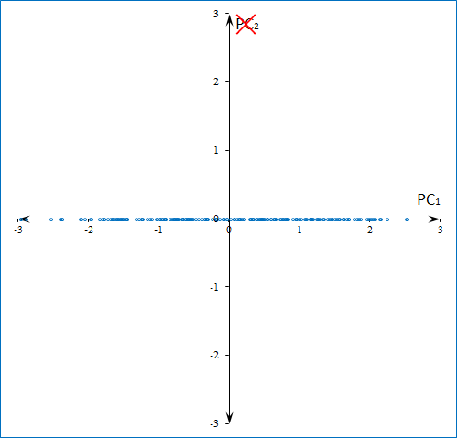
UNIT 2. 2.3. Applications of Principal Components
Dimensional Reduction (6/9)
Dimensional reduction:
We can eliminate the direction represented by 𝑃𝐶₂ that corresponds to the smaller variance:
$$×$$
$${PC}_{2}$$
$${PC}_{1}$$
Notes:
Note:
We can eliminate the direction of smaller variance, that is, ${PC}_{2}$.
This is what the dimensional reduction means.

Slide 54
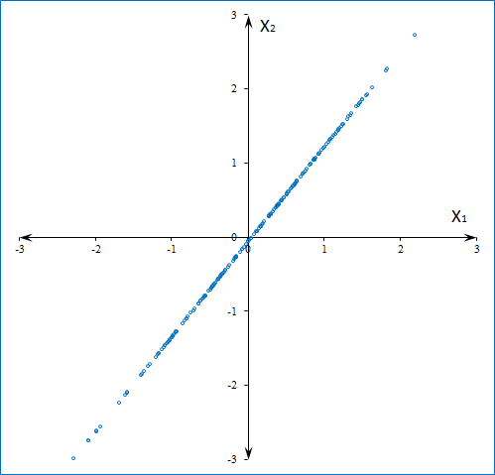
UNIT 2. 2.3. Applications of Principal Components
Dimensional Reduction (7/9)
Dimensional reduction:
Now, we can go back to the original coordinate system and show the “reduced dimensional input”:
$$X_{2}$$
$$X_{1}$$
Notes:
Note:
To show the effect of the dimensional reduction, we go back to the original coordinate system.

Slide 55
UNIT 2. 2.3. Applications of Principal Components
Dimensional Reduction (8/9)
Dimensional reduction:
Now, we can go back to the original coordinate system and show the “reduced dimensional input”:
$$X_{2}$$
Salient feature
$$X_{1}$$
Loss of details
We can notice that details have been lost leaving only the most salient feature.
Notes:
Note:
We can clearly see that the direction of the largest variance “survived” while that of smaller variance has been eliminated.
This way we extract the most salient feature at the expense of “some details”.

Slide 56
UNIT 2. 2.3. Applications of Principal Components
Dimensional Reduction (9/9)
Dimensional reduction:
$$σ_{total}^{2}=σ_{1}^{2}+σ_{2}^{2}+σ_{3}^{2}+…+σ_{k}^{2}$$
The total variance is:
Then, we can calculate the cumulative variance ratios:
$${CVR}_{1}=\frac{σ_{1}^{2}}{σ_{total}^{2}}$$
CVR
1
Target
$${CVR}_{2}=\frac{σ_{1}^{2}+σ_{2}^{2}}{σ_{total}^{2}}$$
$${CVR}_{3}=\frac{σ_{1}^{2}+σ_{2}^{2}+σ_{3}^{2}}{σ_{total}^{2}}$$
$$⋮$$
0
Required
Number of PCs
We can set a target CVR and determine the required number of PCs.
Notes:
Note:
Again, we can analyze the accumulated variance.
We can set a target for the CVR and determine the required number of PCs to reach that target.

Slide 57
UNIT 2. 2.3. Applications of Principal Components
High Dimension Visualization (1/2)
High dimension visualization:
𝑃𝐶₁ and 𝑃𝐶₂ are the directions of the largest and the second largest variance.
𝑃𝐶₁ and 𝑃𝐶₂ define the most spread out plane on which to project the high dimensional coordinates.
$${PC}_{1}$$
$${PC}_{2}$$
Easy to implement: use only the first two components of the transformed scores.
Notes:
Note:
An interesting example of application of the PCs is that of visualization.
High dimensional data is hard to visualize as is.
So, we can “project out” the data points onto a plane defined by the ${PC}_{1}$ and ${PC}_{2}$.

Slide 58
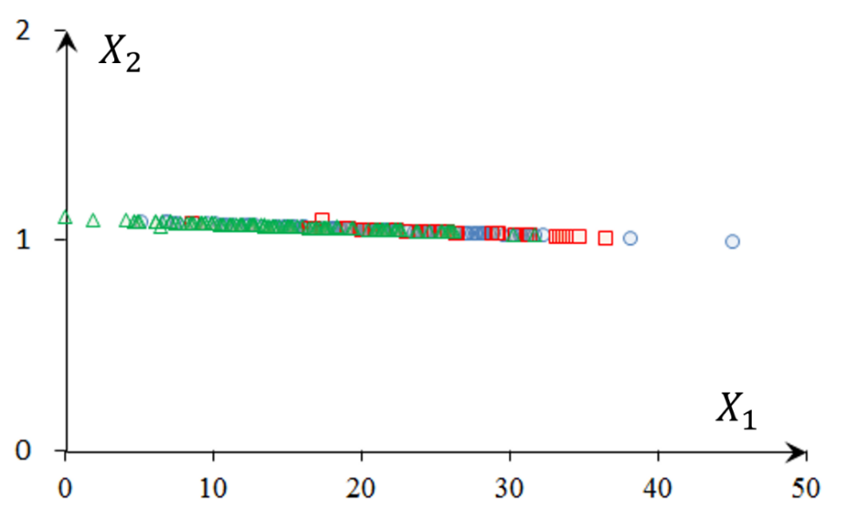
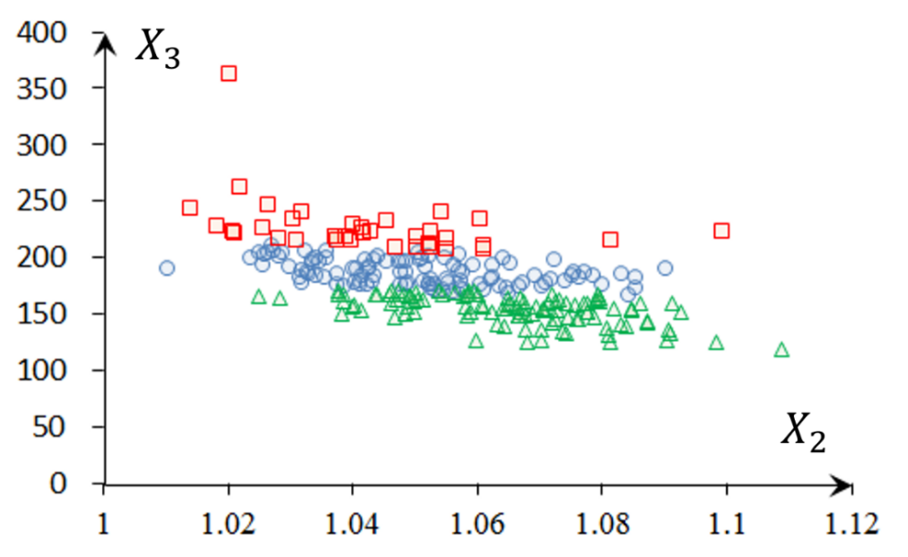
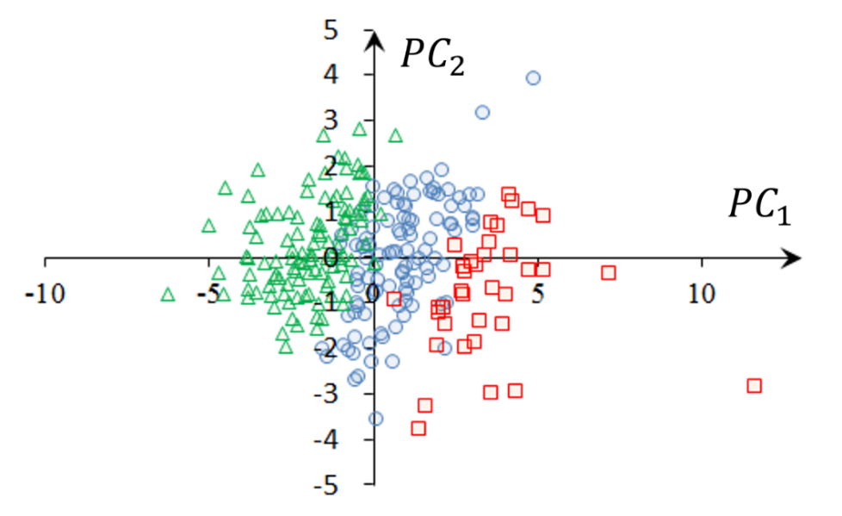
UNIT 2. 2.3. Applications of Principal Components
High Dimension Visualization (2/2)
High dimension visualization:
Ex)
Projected onto the original variable set.
Projected onto the plane defined by ${PC}_{1}$ and ${PC}_{2}$.
Notes:
Note:
In the rightmost picture where the plane is defined by the PCs, we notice that the points are spread out with little overlapping.
Also, the clusters are more clearly distinguished.
However, this technique does not always guarantee a satisfactory result.

Slide 59
UNIT 2. 2.3. Applications of Principal Components
Coding Exercise #0404
Follow practice steps on 'ex_0404.ipynb’ file.
Notes:
Note: WHAT THIS PRACTICE ABOUT
In this practice, we go through some applications of PCA and NMF.
PRACTICE INSTRUCTION
Start Jupyter Notebook. (Refer to steps 1-3 of Coding Exercise # 0401.)
In Jupyter Notebook, click the ex_0404.ipynb files in the Coding Exercise folder.
Review the examples on the topics below: A. Dimensional reduction with PCA. i. Read in data and explore. ii. Visualize the data. iii. Visualize the reduced dimensional input by PCA. iv. Analysis of the cumulative variance ratio (CVR). B. Dimensional reduction with NMF. i. Visualize the reduced dimensional input by NMF. C. Optimized high dimensional visualization with PCA. i. Simulate data. ii. Visualize on the plane defined by PC1 and PC2.
(Optional) Use the blank cell at the bottom to practice your own personal needs.

Slide 60
ⓒ2019 SAMSUNG. All rights reserved.
Samsung Electronics Corporate Citizenship Office holds the copyright of book.
This book is a literary property protected by copyright law so reprint and reproduction without permission are prohibited.
To use this book other than the curriculum of Samsung innovation Campus or to use the entire or part of this book, you must receive written consent from copyright holder.

